Slide 1
Google Gmail
Notes:
Gmail is a free email service provided by Google. It allows users to send and receive emails, organize messages, and manage contacts. Gmail offers a user-friendly interface, ample storage space, and integration with various Google services. It is widely used for personal and professional communication, providing features such as spam filtering, search capabilities, and easy access on both web browsers and mobile devices.

Slide 2
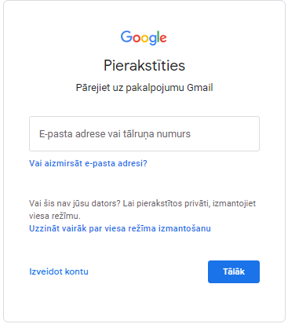
Prieš pradedant darbą
Prisijunkite prie savo Gmail paskyros.
Eikite į www.gmail.com →
Įveskite savo Google paskyros el. pašto adresą ir paspauskite → Kitas
Įveskite „Google“ paskyros slaptažodį ir paspauskite → Kitas
Jei neturite „Google“ paskyros, galite sukurti naują nemokamai → Sukurti paskyrą
Notes:
To sign in to your Google account:
Open your web browser.
Go to drive.google.com.
Click on "Sign In" in the top right corner.
Enter your Google account email address (your username) and the associated password.
Click "Next."
You'll be logged into your Google Drive account, and you can access your stored files and documents.
To create a Google account:
Open your web browser.
Go to accounts.google.com.
Click on "Create account."
Fill in your first and last name, choose a username (your email address), and create a password. Confirm the password.
Provide your phone number for account recovery and security.
Complete the "Birthday" and "Gender" sections.
Click "Next."
Review and accept Google's Terms of Service and Privacy Policy.
Follow the on-screen prompts to add a profile picture and customize your account settings.
Your Google Drive account is now created and ready to use for storing and sharing files.

Slide 3
„Gmail“ apžvalga:
Kaina: Nemokamas naudojimas.
El. pašto adresas: el. pašto adresu (pvz., jūs-decide@gmail.com) turi būti naudojamas Gmail domenas.
Saugykla: 15 GB nemokama saugykla.
Sauga: pagrindinės saugos funkcijos, šlamšto filtrai ir apsauga nuo sukčiavimo.
Palaikymas: problemų sprendimas naudojant „Gmail“ pagalbos centrą.
Palaikomi įrenginiai: galima naudoti staliniuose kompiuteriuose, išmaniuosiuose telefonuose ir planšetiniuose kompiuteriuose. Galima pasiekti per bet kurią žiniatinklio naršyklę ir įvairias programas, skirtas Android ir iOS įrenginiams.
Notes:
Gmail Overview:
Pricing: Free to Use
Gmail is a free email service available to users worldwide, offering essential communication features without any subscription cost.
Email Address: Gmail Domain Requirement
Users must create email addresses with the Gmail domain (e.g., you-decide@gmail.com) when using this free email service.
Storage: 15GB Free Storage
Gmail provides users with a generous 15GB of free storage space, allowing for the accumulation of emails and attachments over time.
Security: Basic Security Measures
Gmail incorporates basic security features, including spam filters and phishing protection, to safeguard users against potential threats and unwanted emails.
Support: Problem-Solving Through Gmail Help Center
Users can access support and troubleshoot issues through the Gmail Help Center, a resource that provides assistance with various aspects of the email service.
Supported Devices: Accessible Across Platforms
Gmail is accessible on desktop computers, smartphones, and tablets, catering to users on different devices. It can be accessed through any web browser and has dedicated apps available for both Android and iOS devices, ensuring flexibility and convenience.

Slide 4
Sąsaja ir navigacija
Meniu ir nustatymai
Paieškos juosta
Profilio piktograma
Rašymo mygtukas
Pasiuntinys
Šoninė juosta ir navigacija
Notes:
Interface and navigation
Inbox: The main screen where you see your emails listed. Emails are usually displayed in a list format, showing the sender, subject line, and a snippet of the email content.
Compose Button: Located prominently, it's where you can start a new email or draft a response.
Search Bar: At the top of the interface, there's a search bar allowing you to search for specific emails using keywords, sender details, dates, or other criteria.
Sidebar and Navigation: On the left-hand side, you'll find the sidebar with folders like Inbox, Sent, Drafts, and more. You can also access other features such as Categories, Snoozed emails, and your customizable Labels. The sidebar also includes shortcuts to other Google services like Google Calendar, Google Drive, and Contacts.
Settings Menu: Accessible via the gear icon, it allows you to customize various settings related to your account, inbox layout, themes, and other preferences.
Profile Icon: Located in the top right corner, clicking on your profile picture or initial gives you access to your Google Account settings, profile information, and options to sign out.

Slide 5
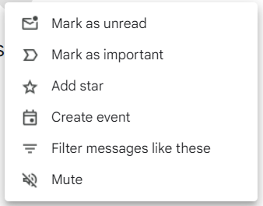
El. laiško atidarymas
Žymėti kaip neskaitytą
Arghyvas
Ištrinti
Naudokite etiketes
Spausdinti
Pranešti apie šlamštą
Perkelti į kitą aplanką
Perdavimas
Atsakyti
Pridėti žvaigždutes
Atsakyti visiems
Notes:
Email Viewing Pane: When you click on an email from the inbox, it opens in the viewing pane on the right, displaying the full content of the email.
Toolbar: When viewing an email, the toolbar offers options to reply, reply all, forward, delete, archive, mark as important, or apply labels. It also includes options to move emails to different folders, add stars, and more.
Reply: Clicking "Reply" allows you to respond to the sender of the email. It opens a new email window with the original message quoted.
Reply All: "Reply All" is used to respond to all recipients of the original email. It includes everyone in the email thread.
Forward: Clicking "Forward" lets you send the selected email to another recipient. It opens a new email window with the original email as an attachment.
Delete: "Delete" removes the selected email permanently from the inbox. Deleted emails are moved to the Trash and can be recovered within a certain period.
Archive: Archiving removes emails from the inbox without deleting them permanently. Archived emails can be found in the "All Mail" section.
Apply Labels: "Apply Labels" allows you to categorize emails for better organization. Labels are customizable and help in sorting and grouping similar emails together.
Move to Different Folders: Gmail doesn't use traditional folders but uses labels. You can move emails to specific labels to organize and categorize them effectively.
Add Stars: Adding stars is a quick way to mark emails for attention or categorization. Gmail offers different colored stars for various priorities.
More Options: The "More" button provides additional actions, including options like "Mark as Unread," "Snooze," and "Filter messages like these."
Report Spam: If an email is unwanted or suspicious, you can use "Report Spam" to move it to the Spam folder and help Gmail improve its spam filters.
Print: The "Print" option allows you to print the selected email, useful for keeping hard copies or documents.
"Mark as Unread" option in Gmail allows you to change the status of a read email back to unread. This is helpful when you want to revisit or prioritize specific emails.

Slide 6
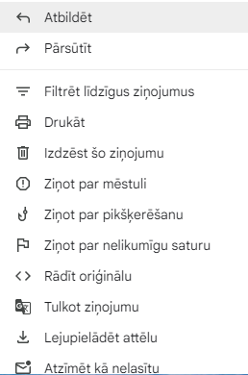
El. pašto persiuntimas
Atidarykite el. laišką: gautuosiuose spustelėkite el. laišką, kurį norite persiųsti, kad jį atidarytumėte.
Mygtukas Pirmyn: el. pašto lango viršutiniame dešiniajame kampe yra mygtukas „Išplėstinės parinktys“ (trys vertikaliai sulygiuoti taškai). Spustelėkite jį. Išskleidžiamajame meniu pasirinkite „Persiųsti“.
Sukurkite persiųstą el. laišką: atsidarys naujas el. pašto langas, kuriame pradinis el. laiškas pridėtas kaip citata. Lauke „Kam“ pridėkite gavėjo el. pašto adresą. Jei reikia, galite pridėti bet kokį papildomą pranešimą.
Siųsti persiųstą el. laišką: kai būsite pasiruošę, spustelėkite mygtuką „Siųsti“, kad persiųstumėte el. laišką.
Notes:
Forwarding Emails
Open the Email: Click on the email you want to forward in your inbox to open it.
Forward Button: At the top right of the email window, there's a "More options" button (three vertically aligned dots). Click on it. From the dropdown menu, select "Forward."
Compose the Forwarded Email: A new email window will open with the original email attached as a quote. Add the recipient's email address in the "To" field. You can add any additional message if needed.
Send the Forwarded Email: Once you're ready, click the "Send" button to forward the email.

Slide 7
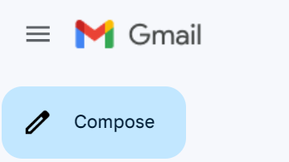
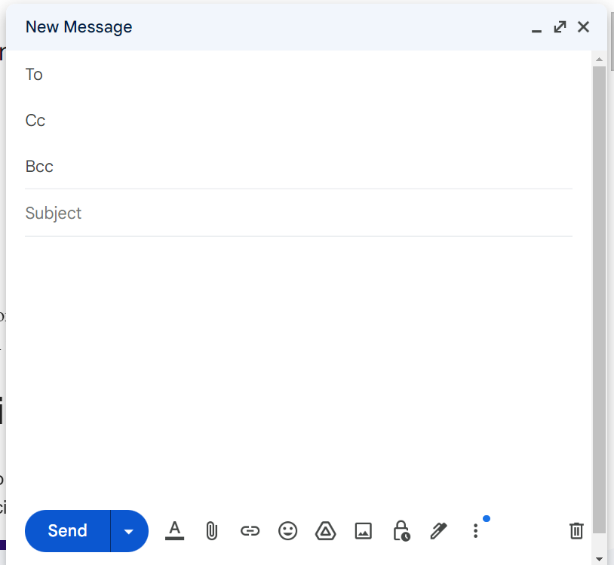
Laiškų kūrimas ir siuntimas
Įveskite gavėją (-us)
Pridėti temą
Parašykite savo el
Failų pridėjimas
Patikrinkite, ar nėra klaidų
Siųsti el.laišką
Notes:
Click on the "Compose" Button: In the top left corner of the Gmail interface, you'll see "Compose" button. Click on it to start drafting a new email.
Enter Recipient(s): In the "To" field, enter the email address of the recipient(s). You can also add recipients in the "Cc" field for carbon copy or "Bcc" for blind carbon copy.
Add a Subject: Enter a brief and descriptive subject line for your email in the subject field.
Write Your Email: Click in the large text area below the subject line to start typing your email. You can format text, add links, insert images, and use various formatting options from the toolbar at the bottom of the composing window.
Attaching Files: To attach files, click on the paperclip icon in the toolbar. You can attach documents, images, or other files from your device or Google Drive.
Check for Errors: Review your email for any errors in content, recipient addresses, or attachments.
Send the Email: Once you're ready to send the email, click the "Send" button in the bottom left corner of the composing window.
Confirmation Message: After sending, Gmail will typically display a confirmation message at the bottom left corner of the screen indicating that the email has been sent.
Sent Mail: Your sent email will appear in the "Sent" folder, allowing you to review it later if needed.

Slide 8
Laiškų formatavimas (šriftas)
6
3
2
5
1
4
Pusjuodis, kursyvas, pabrauktas: naudokite šias parinktis norėdami pabrėžti tekstą.
Šrifto spalva: pakeiskite pasirinkto teksto spalvą.
Teksto lygiavimas: lygiuokite tekstą kairėje, dešinėje, centre arba lygiuokite jį.
Sąrašai su numeriais arba su ženkleliais: kurkite sąrašus, kad galėtumėte geriau organizuoti.
Teksto dydis: pakeiskite pasirinkto teksto šrifto dydį.
Išvalyti formatavimą: pašalinamas visas pasirinkto teksto formatavimas ir grąžinami numatytieji nustatymai.
Notes:
Formatting Emails (Font)
Bold, Italics, Underline: Select the text you want to format. Click the "B" for bold, "I" for italics, or "U" for underline in the formatting toolbar at the bottom of the compose window.
Text Color: Select the text you want to change the color of. Click the "A" icon with a colored bar in the formatting toolbar. Choose a color or enter a hex code for a specific color.
Alignment: Use the alignment icons to align text left, center, right, or justify it.
Lists: To create a numbered or bulleted list, click on the respective list icons in the formatting toolbar.
Font Size and Font Style: Highlight the text. Use the dropdown menu in the formatting toolbar to choose the desired font size. Gmail offers various font styles within the formatting toolbar, such as Arial, Verdana, etc.
Quoting Text: While replying to an email, select the text you want to quote. Click the quotation mark icon in the formatting toolbar to format it as a quote.
Undo/Redo and More: Undo (Curved Arrow Icon), Redo (Straight Arrow Icon): Allows you to undo or redo changes made to your email.
More Options (Three Dots): Additional formatting options like strikethrough, subscript, superscript.
Clear Formatting: Removes all formatting from selected text, reverting it to default settings.

Slide 9
Laiškų formatavimas (elementai)
Hipersaitai
Vaizdai
Parašai
Jaustukų rinkiklis
Failo priedas
Įdėti failus iš „Google“ disko
Įjungti konfidencialų režimą
Notes:
Formatting Emails (Elements) File Attachment: Use the paperclip icon to attach files directly from your device.
Tips for Attachments:
File Size Limit: Gmail has a limit on attachment sizes, which is typically around 25 MB per email. If your attachment exceeds this limit, consider using Google Drive to share larger files.
Supported File Types: Gmail generally supports a wide range of file types for attachments, including documents, images, videos, and more. However, certain file types might be restricted for security reasons.
Google Drive Integration: For larger files or when sending multiple attachments, you can upload files to Google Drive and share them as links in your email. Click on the Drive icon in the compose window to attach files from Drive or insert Drive links.
Hyperlinks: Highlight the text you want to hyperlink. Click the link icon (chain link) in the toolbar. Enter the URL you want to link to and click "OK.” Emoji Picker: Click on the smiley face icon in the formatting toolbar to access the emoji picker. This allows you to insert emojis into your email's text or subject line.
Insert Files from Google Drive: Click on the Google Drive icon, and a pop-up window will appear. Here, you can navigate through your Google Drive folders to select the file(s) you want to attach.
Images: Place the cursor where you want to insert the image. Click the image icon in the toolbar. Upload an image from your device or select one from Google Drive. Enable Confidential Mode: At the bottom of the email composition window, you'll find a padlock icon with a clock. Click on it to enable Confidential Mode.
Set Expiration Date: You can choose an expiration date for the email, after which the recipient won't be able to access it. Options include a day, week, month, or a custom date.
Additional Security Measures: You can also set a passcode (SMS passcode) that the recipient needs to enter to open the email. Optionally, you can disable the recipient's ability to forward, copy, download, or print the email by checking the respective options.
Signatures:
Custom Signatures: Create personalized signatures that include your name, title, contact information, and links to your website or social media profiles.
Rich Text Signatures: Format signatures using different fonts, colors, and styles for a professional appearance.

Slide 10
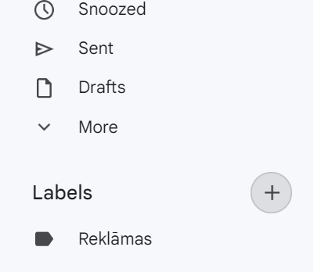
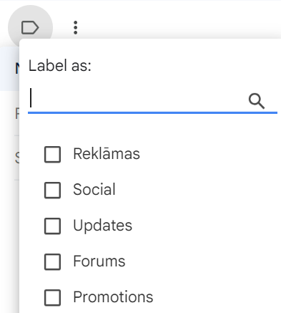
Etiketės:
Etikečių kūrimas:
Kairėje šoninėje juostoje raskite skiltį „Etiketės“.
Spustelėkite „Sukurti naują etiketę“ (+) ir suteikite jai pavadinimą.
Galite sukurti įdėtas etiketes, kad struktūra būtų labiau organizuota.
Etikečių taikymas:
Pasirinkite el. pašto adresą (-ius), kurį (-iuos) norite pažymėti.
Įrankių juostoje spustelėkite etiketės piktogramą (atrodo kaip žyma).
Pasirinkite etiketę (-es), kurią (-es) norite taikyti.
Notes:
Labels
Creating Labels:
On the left sidebar, find the "Labels" section.
Click on "Create new label” (+) and give it a name.
You can create nested labels for a more organized structure.
Applying Labels:
Select the email(s) you want to label.
Click on the label icon (looks like a tag) in the toolbar.
Choose the label(s) you want to apply.

Slide 11
Paieška
Paieškos juosta: yra „Gmail“ sąsajos viršuje. Įveskite raktinius žodžius, siuntėjo vardą, temą arba bet kokį konkretų turinį, kurio ieškote.
Paieškos operatoriai: norėdami susiaurinti rezultatus, naudokite konkrečius paieškos terminus arba operatorius.
Pavyzdžiai:
from: john@example.com (Ieškoti el. laiškų iš konkretaus siuntėjo)
tema: susitikimas (Ieškoti el. laiškų konkrečia tema)
turi: priedą (Ieškoti el. laiškų su priedais)
iki: 2023/01/01 (Ieškoti el. laiškų, išsiųstų iki tam tikros datos)
Notes:
Gmail Search: Find What You Need Fast
Use the Search Bar: Locate the search bar at the top of the Gmail interface.
Type your search query directly into the search bar. You can search for keywords, sender names, subject lines, or any other relevant information.
Press the "Enter" key on your keyboard, or click the magnifying glass icon to initiate the search.
Gmail will display search results based on your query. The relevant emails matching your search will be listed.
If you want to refine your search, click on the search bar to access advanced search options. Here, you can specify criteria like sender, recipient, subject, date, and more.
You can use keywords and operators to make your search more specific. For example:
Use from: to search for emails from a specific sender (e.g., from:john@example.com).
Use subject: to search for emails with a specific subject (e.g., subject:meeting).
Use after: and before: to search for emails within a specific date range.

Slide 12
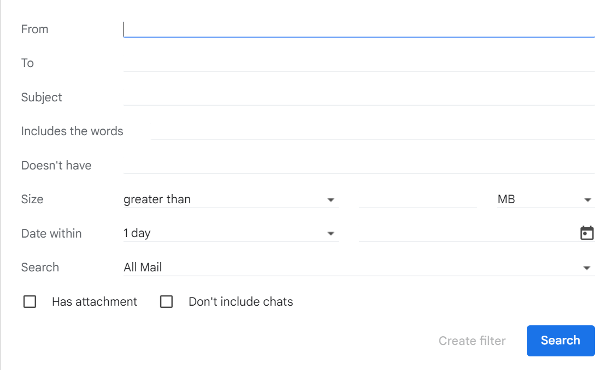
Išplėstinė paieška
Paieškos juostoje spustelėkite išskleidžiamojo meniu rodyklę: parinktys apima siuntėją, gavėją, temą, raktinius žodžius, dienų seką ir kt.
Kelių kriterijų naudojimas: sujunkite paieškos kriterijus įvesdami tiesiai į paieškos juostą arba naudodami išplėstinės paieškos laukelį.
Notes:
Advanced search
Access Advanced Search Options: After entering your initial search query, you can directly access advanced search options by clicking on the small gray arrows at the right end of the search bar. This opens a drop-down menu with various search fields.
Specify Search Criteria:
In the drop-down menu, you can specify various criteria such as:
From, To, Subject: Use these fields to search for emails from specific senders, to specific recipients, or with specific subjects.
Has the words: Search for emails containing specific words or phrases.
Date within: Specify a date range for your search.
More options: Additional criteria like attachments, size, and labels are available under "Search options."
Combine Criteria: You can combine multiple criteria by filling in the relevant fields.
Press Enter or Click the Search button to initiate the advanced search.

Slide 13
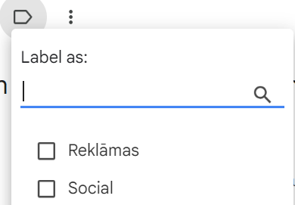
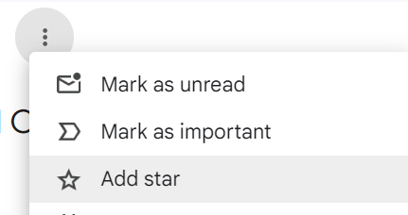
Žvaigždės, etiketės ir svarbūs žymekliai:
Žvaigždė:
Spustelėkite el. laišką, kad jį pasirinktumėte.
Spustelėkite žvaigždutės piktogramą įrankių juostoje, kad pridėtumėte arba pašalintumėte žvaigždutes.
Etiketė:
Gmail automatiškai suskirsto el. laiškus į skyrius, pvz., Pagrindinis, Socialinis, Reklamos ir kt.
Galite vilkti el. laiškus tarp kategorijų, kad juos perklasifikuotų.
Svarbumo žymekliai:
„Gmail“ el. laiškams priskiria svarbos žymeklius, atsižvelgdama į jūsų sąveiką.
Galite rankiniu būdu pažymėti el. laišką kaip svarbų arba nesvarbų.
Notes:
Stars, labels, and importance markers in Gmail are tools designed to help you organize, prioritize, and categorize your emails. Here's how you can use each of them:
Stars:
Purpose: Stars are visual indicators that help you mark and quickly identify important emails or those that require attention.
How to Use:
Click on the star icon next to an email to add or remove a star.
You can use different colored stars for various levels of importance.
Labels:
Purpose: Labels are like folders that allow you to categorize and organize your emails in a way that makes sense to you.
How to Use:
Select an email, click on the label icon, and choose or create a label.
Emails with labels are easily accessible through the left sidebar.
Importance Markers:
Purpose: Gmail's importance markers use algorithms to automatically identify and prioritize important emails based on your interactions.
How to Use:
Gmail automatically marks some emails as important.
You can manually mark or unmark emails as important using the "Mark as important" button.

Slide 14
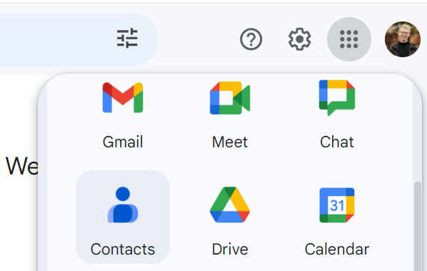
Kontaktų ir kontaktų grupių tvarkymas
Eikite į „Google“ kontaktus:
Atidarykite „Gmail“ ir viršuje dešinėje spustelėkite piktogramą „Google Apps“ (dažniausiai kvadratų tinklelis).
Išskleidžiamajame meniu pasirinkite „Kontaktai“.
Notes:
Google Contacts is a web-based contact management tool provided by Google. It allows users to store and organize their contacts in a centralized location, making it easy to access and manage contact information across various Google services.
Go to Google Contacts:
Open Gmail and click on the "Google Apps" icon (usually a grid of squares) at the top right.
Select "Contacts" from the dropdown menu.

Slide 15
Kontaktų ir kontaktų grupių tvarkymas
Pridedamas kontaktas:
Rankiniu būdu pridėti kontaktus:
Spustelėkite „Sukurti kontaktą“ arba mygtuką „+“.
Įveskite kontakto duomenis, įskaitant vardą, el. pašto adresą, telefono numerį, adresą ir kt.
Išsaugokite kontaktą.
Notes:
Adding a Contact:
Click "Create": On the left side, click the "Create" button or the "+" button to add a new contact.
Enter Contact Information: Fill in the contact details, including the person's name, email address, phone number, and any additional information you want to include.
Add Additional Fields: Click on "Add" to include additional fields like addresses, birthdays, and custom notes.
Add a Profile Picture (Optional): Click on the camera icon to add a profile picture for the contact.
Save the Contact: Once you've entered the information, click "Save" to save the new contact.

Slide 16
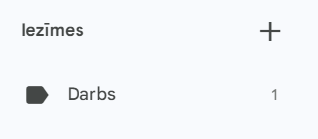
Kontaktų grupių kūrimas
Grupės kūrimas:
Kairėje šoninėje juostoje spustelėkite „Etiketės“ arba „Sukurti etiketę“, kad sukurtumėte naują grupę.
Pavadinkite grupę (pvz., „Darbo kontaktai“, „Šeima“ ir kt.).
Kontaktų įtraukimas į grupes:
Atidarykite kontaktą arba kelis kontaktus, kuriuos norite įtraukti į grupę.
Spustelėkite „Etiketė“ arba „Grupės“ ir pasirinkite norimą (-as) grupę (-es), prie kurios norite pridėti kontaktą (-us).
Notes:
Creating Contact Groups:
Select Contacts: On the left side, select the contacts you want to include in the group
Click "Label" or "Manage labels": At the top, click on "Label" or "Manage labels".
Create a New Label: If you haven't created a label before, click "Create label" and give your label a name (e.g., "Work Contacts" or "Family").
Save the Label: Click "Save" to create the label.

Slide 17
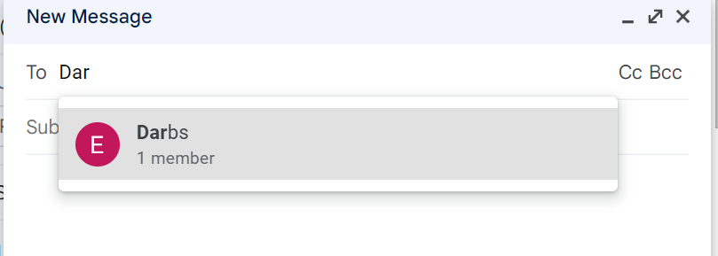
Siųsti el. laišką kontaktų grupei
Notes:
Send email to contact group
Click on the "Compose" button to start a new email.
In the "To" field, enter the label name you created for the contact group. Gmail will suggest the label as you type.
Click on the suggested label to add the entire contact group to the recipient list.
Complete the email by adding a subject, writing your message, and attaching any files if necessary.
Click "Send" to send the email to the entire contact group.

Slide 18
„Gmail“ funkcijos ir privalumai I
Patogi vartotojo sąsaja: „Gmail“ turi intuityvią ir lengvai naudojamą sąsają, todėl vartotojams paprasta naršyti ir tvarkyti el.
Didelė saugykla: suteikia daug laisvos vietos saugykloje (15 GB), todėl galite išsaugoti daugybę el. laiškų ir priedų nepritrūkdami vietos.
Galinga paieška: „Gmail“ paieškos funkcija yra patikima, todėl vartotojai gali lengvai rasti konkrečius el. laiškus naudojant raktinius žodžius, siuntėjo informaciją ar kitus kriterijus.
Etiketės ir filtrai: naudotojai gali efektyviai tvarkyti savo el. laiškus pritaikydami etiketes ir nustatydami filtrus, kurie automatiškai skirsto į kategorijas gaunamus el. laiškus, kad būtų lengviau nustatyti ir tvarkyti pranešimus.
Saugos funkcijos: „Gmail“ įdiegia stiprias saugos priemones, įskaitant šlamšto filtravimą, sukčiavimo aptikimą, dviejų veiksnių autentifikavimą ir šifravimą, kad apsaugotų vartotojų paskyras ir duomenis.

Slide 19
„Gmail“ funkcijos ir privalumai II
6. Prieiga neprisijungus: naudodami „Gmail“ neprisijungus funkciją, vartotojai gali pasiekti savo el. laiškus net neturėdami interneto ryšio, todėl jie gali skaityti, atsakyti ir rašyti el. laiškus neprisijungę.
7. Mobilioji prieiga: „Gmail“ mobilioji programėlė prieinama tiek „Android“, tiek „iOS“ įrenginiams, suteikianti patogią prieigą prie el. laiškų išmaniuosiuose telefonuose ir planšetiniuose kompiuteriuose.
8. Tinkinimo parinktys: vartotojai gali tinkinti savo gautuosius naudodami įvairias temas ir nustatymus, kad atitiktų jų pageidavimus ir optimizuoti el. pašto valdymo patirtį.

